Slide 1
Exercise-2: Include and Demonstrate HTML5 APIs
Objectives:
To develop a responsive web application using HTML5 semantic elements, Tailwind CSS, JavaScript, and relevant HTML5 APIs based on the selected domain requirements.
Students are required to identify suitable HTML5 APIs that add value to their chosen domain and integrate a minimum of FIVE HTML5 APIs into their application.

Slide 2
Examples of HTML5 APIs include:
Geolocation API
Local Storage API
Session Storage API
Audio API
Video API
Canvas API
Drag and Drop API
Web Workers API
History API
Fullscreen API
Clipboard API
Web Notifications API
Device Orientation API
File API

Slide 3
Problem Statement and Software Required
Problem Statement: Enhance the existing landing page by integrating HTML5 APIs and functionalities to create a more interactive user experience.
Software Required
VS Code
Chrome Browser
Git
GitHub Account

Slide 4
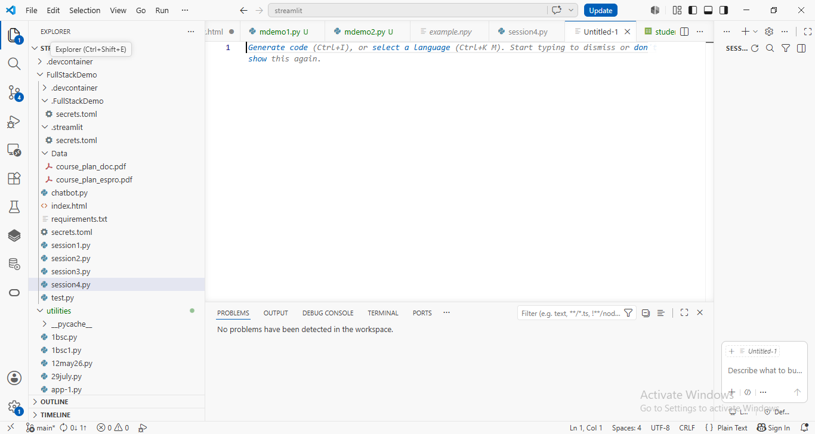
1. Open VS Code and create a project or use existing repository:

Slide 5
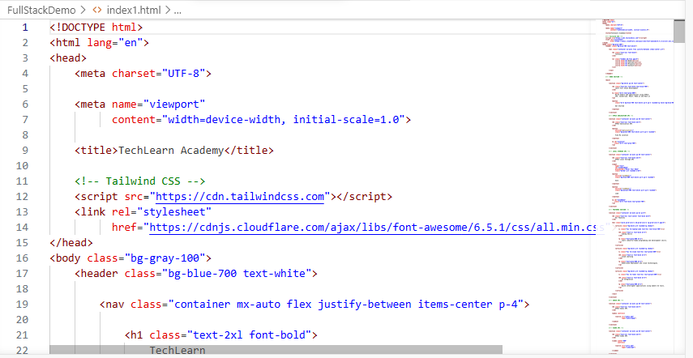
2. Create: index1.html

Slide 6
3. Design a responsive webpage.
By using HTML5 and Tailwind CSS:
Header
Navigation Bar
Hero Section
Features Section
Footer

Slide 7
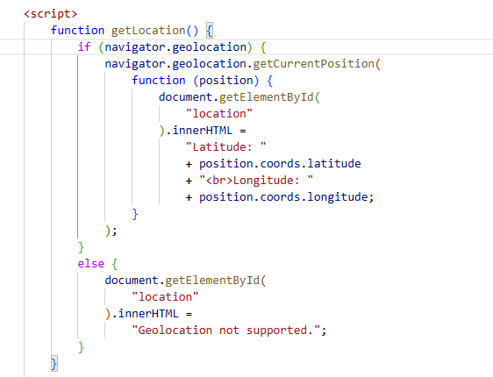
4. Implement the Geolocation API
Add a button to retrieve the user's location.
Display Latitude and Longitude.

Slide 8
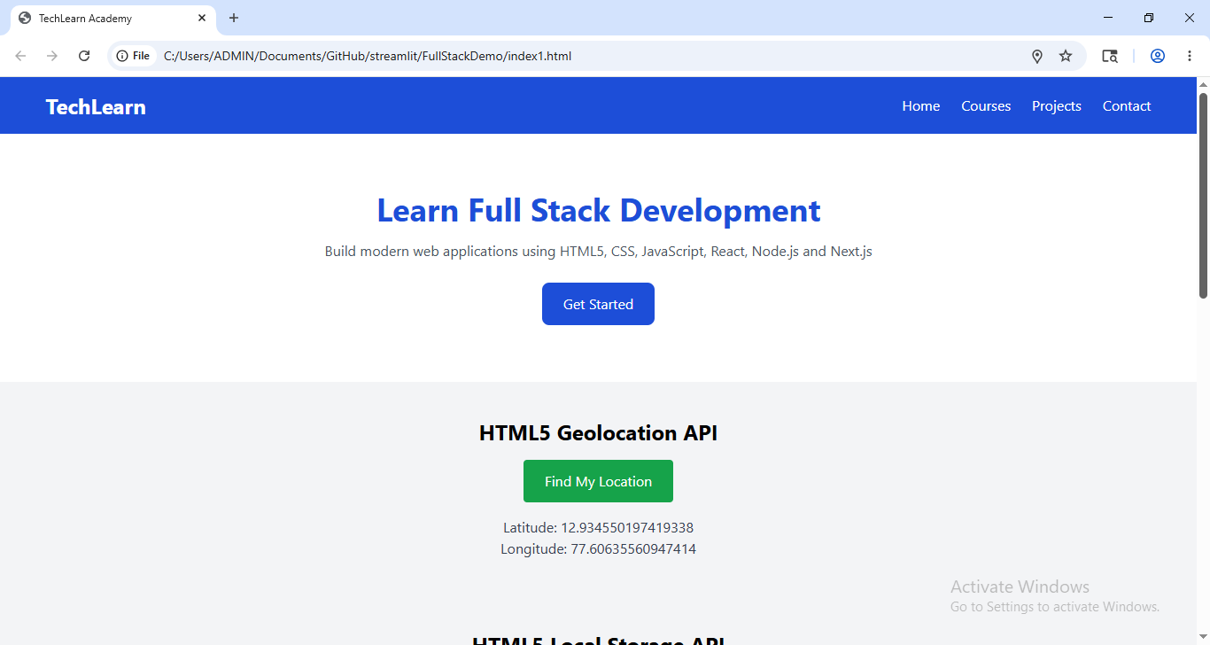
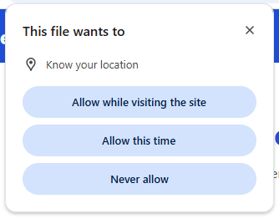
Geolocation API

Slide 9
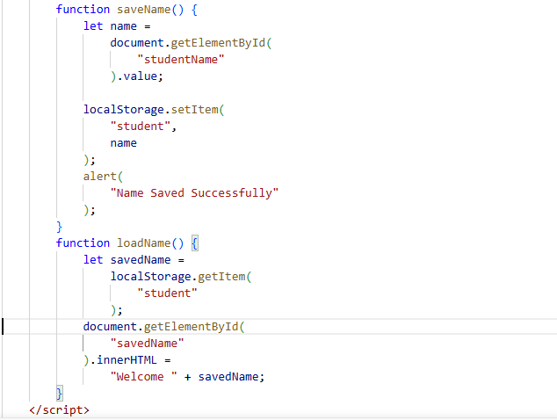
5. Implement the Local Storage API
Accept user input.
Save data using Local Storage.
Retrieve and display stored data.

Slide 10
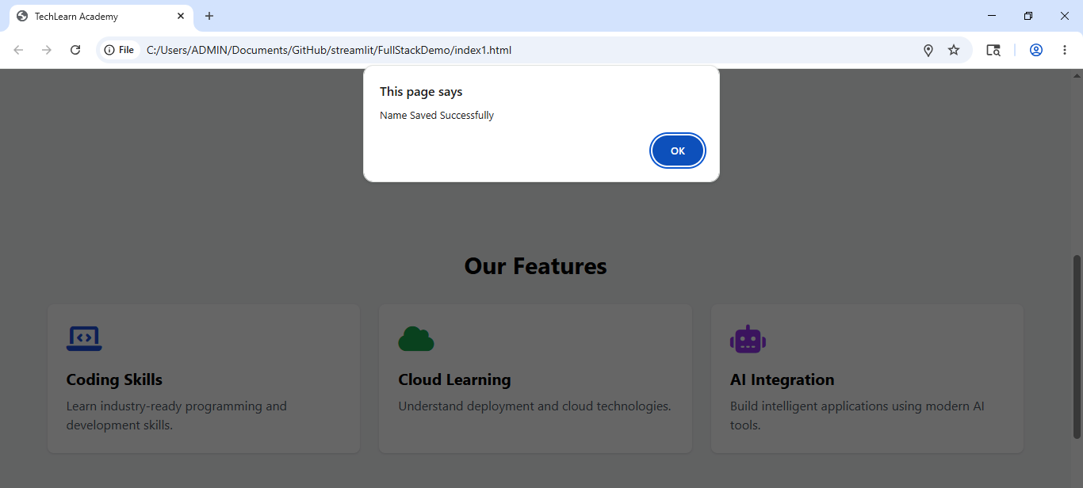
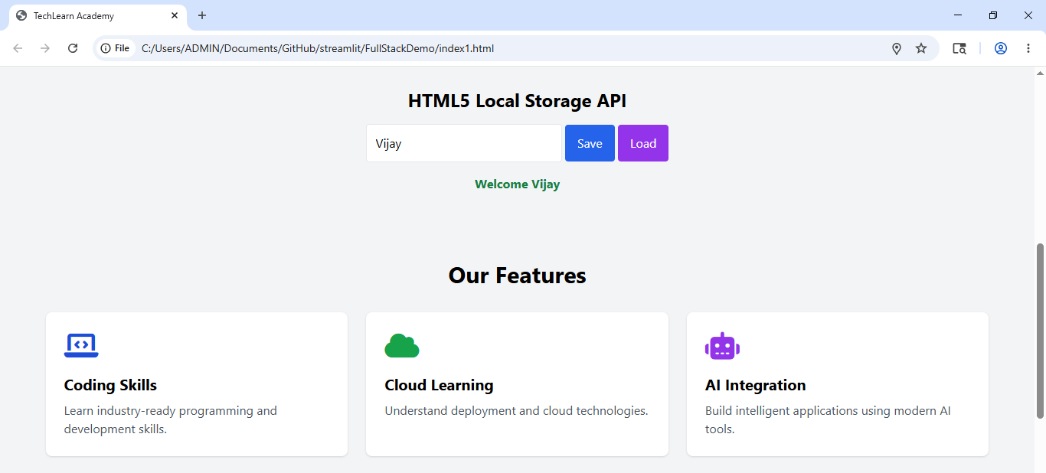
Local Storage API

Slide 11
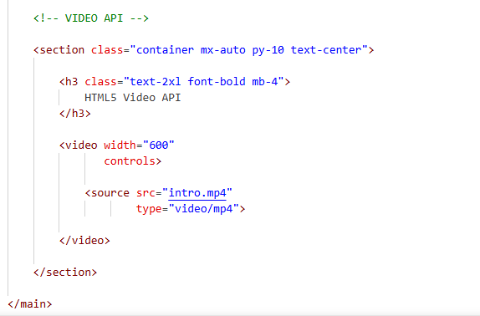
6. Embed multimedia content
Add using
HTML5 Audio Element
HTML5 Video Element

Slide 12
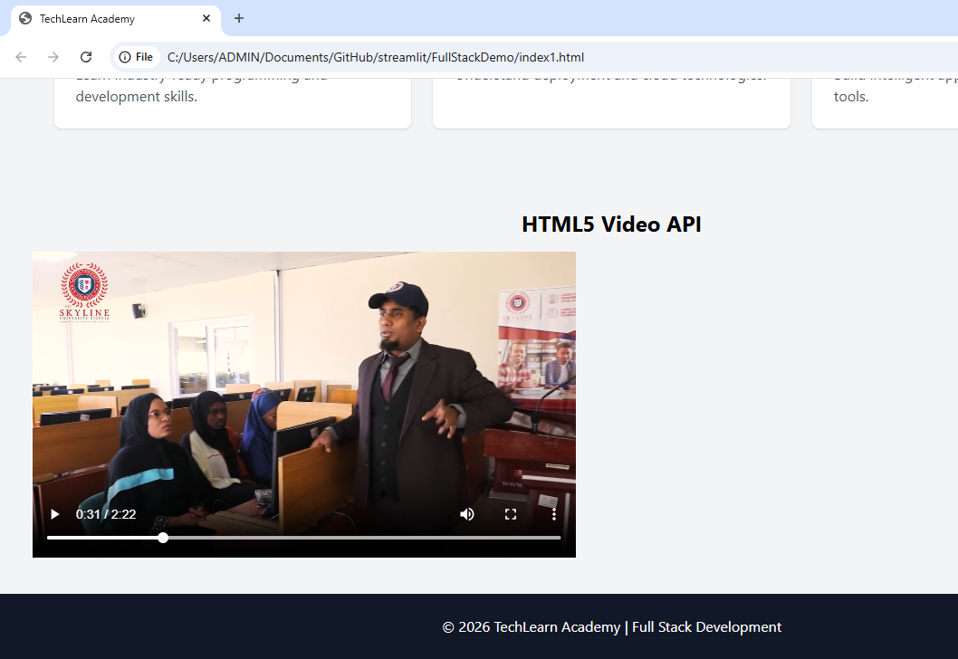
Embed multimedia content

Slide 13
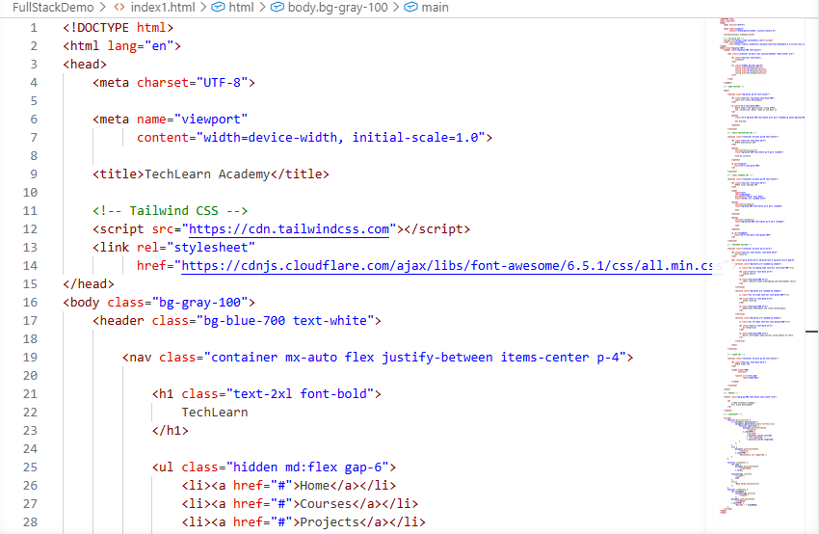
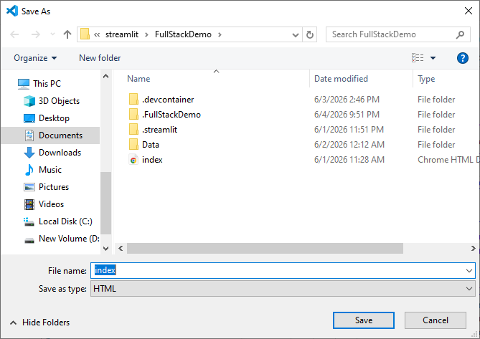
5. Save the file.

Slide 14

6. Run and Verify webpage output.

Slide 15
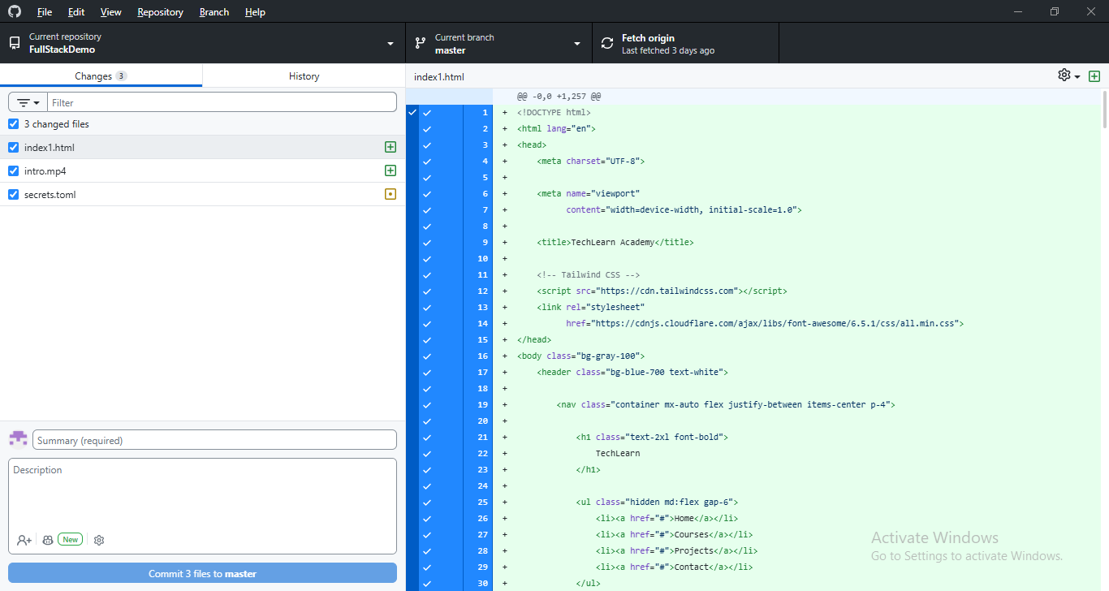
7. Push index1.html to GitHub Repository

Slide 16
Additional Suggestions for Creativity
Students may additionally integrate:
Canvas API
Drag and Drop API
Dark Mode Toggle
Theme Customization
AI-assisted Enhancements

Slide 17
Submission Deliverables
Upload a single PDF containing:
1. Source Code (index1.html)
2. Screenshots (API Integrations)
3. GitHub Repository Link (GitHub Repository URL)
4. AI Usage Declaration (AI Tools and Purpose)
5. Reflections [Optional]

Slide 18
Marking Rubrics
Execution/ Implementation – 2M
Formatting & Validation – 2M
Concept Clarity/ Viva– 2M
Complexity/ Self Learning/ On-Spot Task Completion – 2M
GitHub Collaboration/ Deployment – 2M
Final Note
Test the application thoroughly for any bugs or issues.
Save and build the GitHub project for submission.
Additional Suggestions for Creativity: API Integration based on your domain

